Slide 1
Virtual Private Network(VPN)
A technology that allows for the extension of a private or local network to hosts that might not be on that network.
Shortly a person can access the private network virtually.
Redirect
Tunnelling protocol.

Slide 2
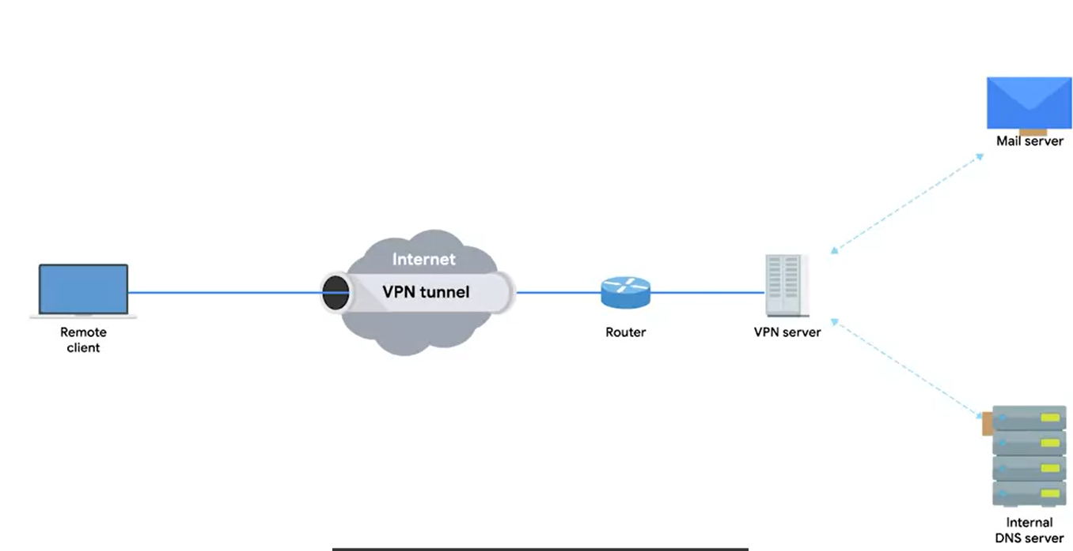

Slide 3
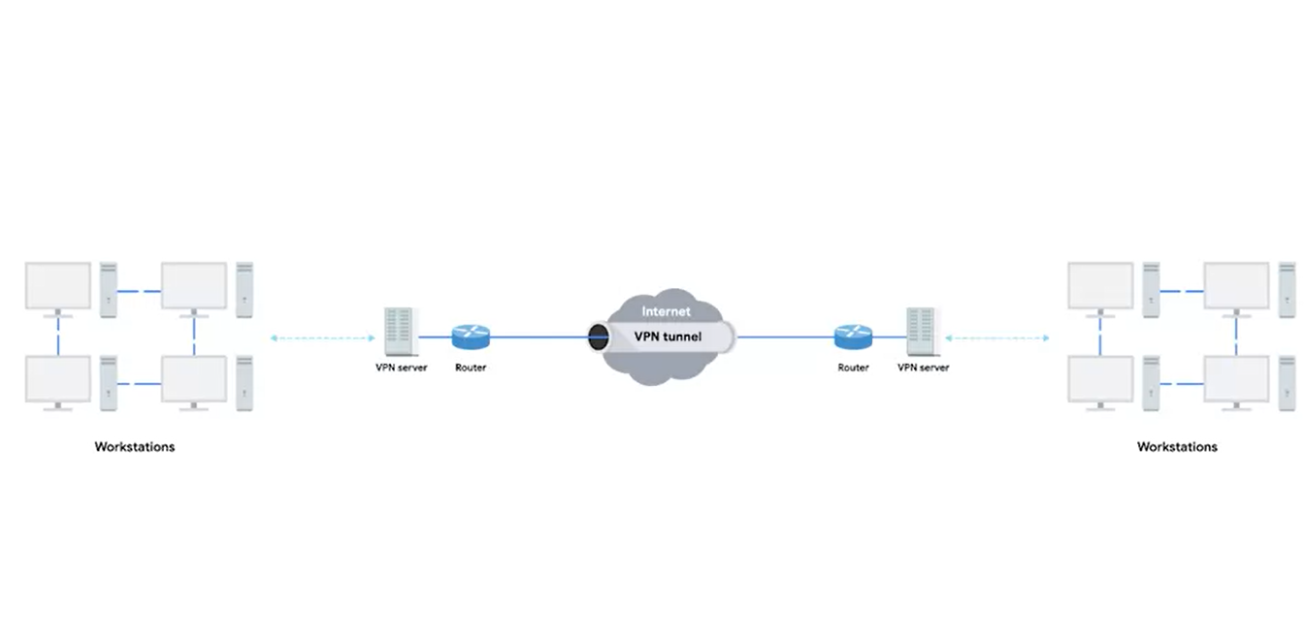

Slide 4
Uses of VPN
Any host outside of network could access internal resources just like if it was physically connected to the private network.

